Slide 1
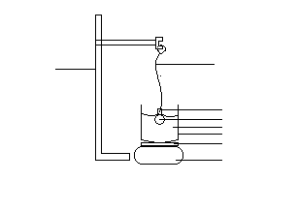
thread
Retort stand
Specific gravity bottle
glycerin
water
Beaker
Hot plate
Electronic heater

Slide 2
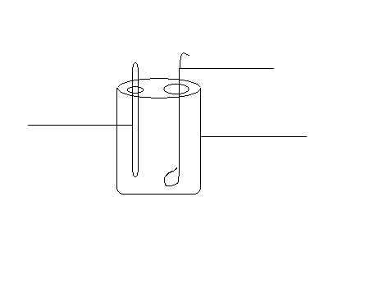
Stirrer
thermometer
calorimeter

